Slide 1

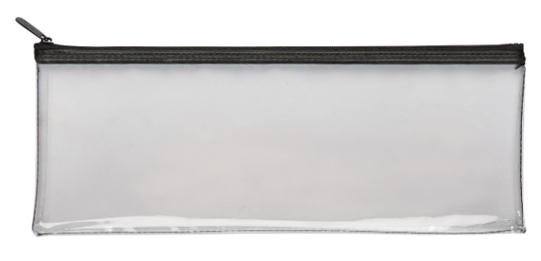
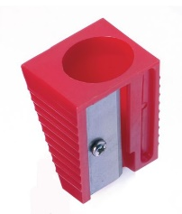
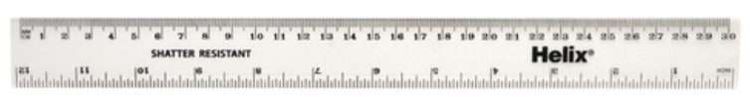
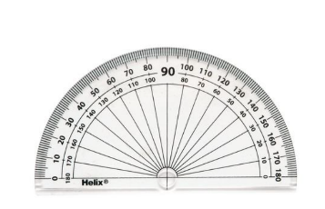
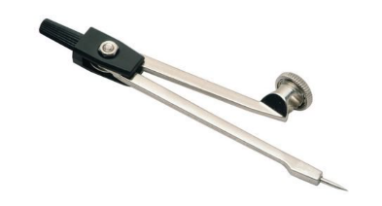

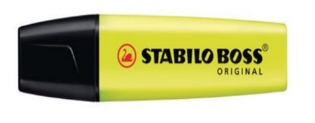


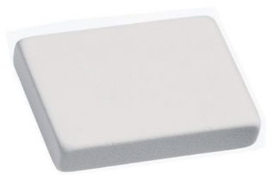
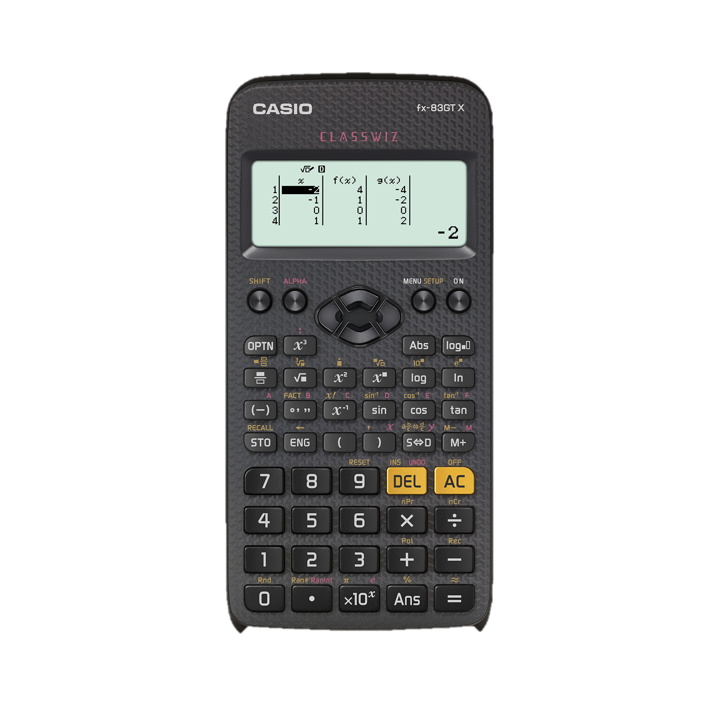
Equipment
1.
6.
7.
2.
3.
4.
5.
8.
9.
10.
Students will need:
A clear pencil case – suitable for assessments
A 30 cm ruler. A fixed length rather than a foldable one will last longer
Black or blue biros – at least 3
A green pen for improving work
A pencil – at least 2
A sharpener
A protractor
A compass
A highlighter pen – at least 1
A rubber
A scientific calculator. Casio or Aurora are best.
11.

