Slide 1
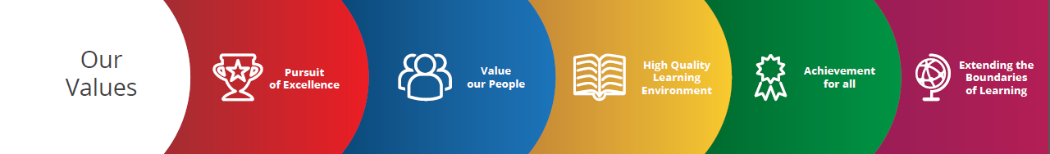


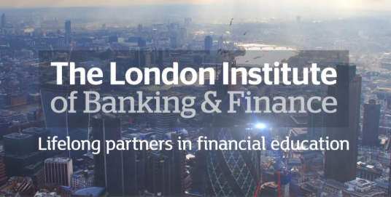
Key Stage 5 Financial Studies | Curriculum aims | Curriculum content | Curriculum Delivery
Year 12 | Our curriculum is based upon the LIBF specification. Students will study for a stand alone qualification of Certificate in Financial Studies. Students are encouraged to become responsible borrowers and sensible savers, and to appreciate the need for financial planning throughout their life. Students will gain an appreciation of why money is important through focusing on what money is, attitudes to it and how it can affect life choices. To maintain 2019 ALPS score of 2. | LIBF Certificate in Financial Studies specification; https://www.libf.ac.uk/study/financial-capability/qualifications/certificate-in-financial-studies-(cefs) Financial Capability for the Immediate and Short Term Financial Capability for the Medium and Long Term | There will be eight taught hours per fortnight in the department. Lessons will be based on discussion of key concepts, leading to the production of effective classroom notes. Initial student research is a key element of classroom practice. Exam technique is considered, developed and analysed throughout our curriculum delivery. Formal examinations are sat in January and May.
Year 13 | In year 13, students will study for the Diploma in Financial Studies. This consolidates the curriculum aims of the Certificate. In terms of syllabus content, it extends the content of the Certificate in Financial Studies to include areas such as sustainability in the wider financial services system, and the long-term effect of debt. To maintain 2019 ALPS score of 2. | LIBF Diploma in Financial Studies specification; https://www.libf.ac.uk/study/financial-capability/qualifications/diploma-in-financial-studies-(dipfs) Sustainability of an Individual’s Finance Sustainability of the Financial Services System | There will be eight/nine taught hours per fortnight in the department. The Diploma builds on the skills and knowledge students gain when completing the Certificate in Financial Studies. In addition, this qualification prepares students for further study by developing their core skills of independent thinking, critical analysis and evaluation, verbal communication (through classroom discussion) and written communication. Formal examinations are sat in January and May.

