Slide 1

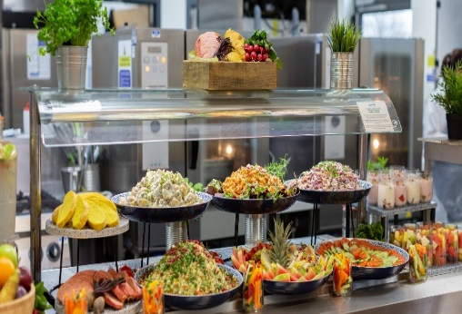
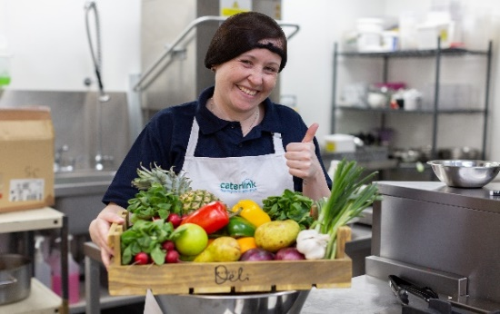
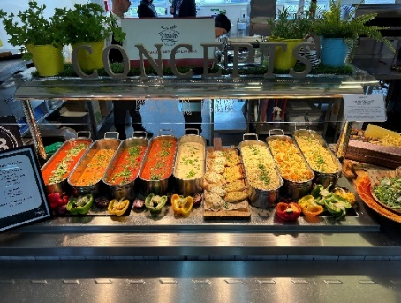
Welcome to
Check out the benefits of a Caterlink school meal below or get in touch for more information!
Freshly prepared dishes daily - We pride ourselves on using the highest quality products, using highly trained teams to prepare and cook fresh dishes daily using raw ingredients to assemble tasty, nutritious dishes. Check out our menus www.caterlinkltd.co.uk
Local Supply – We use both local suppliers and locally grown produce wherever possible within our menus, limiting food miles and maximising freshness! Using UK suppliers to purchase our goods.
Innovation in Menu Planning - Exceeding the Children's Food Trust recommendations, Caterlink have reduced the sugar within our desserts, ensuring that all contain 6.5g of free sugars or less, and our menus are accredited by Food for Life Served Here.
Helping to save the planet - We have developed a number of 50% plant-based protein dishes to our menus - these are a good source of protein and help reduce greenhouse gasses vs. using meat and dairy.
Plastic Reduction - We're industry leaders in reducing plastic and have removed clingfilm from our primary school kitchens, removed all single use plastics from point of service, plus reduced packaging from our suppliers and train our teams in sustainability.

Slide 2
Our Extra Touches
Supportive - Caterlink offer our catering teams a supportive working environment in which they can develop and flourish, with benefits including a host of professional qualification opportunities, access to various physical and mental health support programmes, plus a range of awards and events that celebrate their successes.
Refreshing - We want every child to actively choose a school meal, and as everyone first eats with their eyes, we invest in service ware to ensure attractive presentation of our meals
Engaging - We are committed to actively engaging with both pupils and parents throughout the school year, highlighting the many benefits of a school meal and responding to their feedback to help us maximise uptake and ensure your pupils are properly fuelled to achieve their potential.
Community minded - From funding kitchen gardens at schools through our very own registered charity, to delivering cookery workshops that empower parents to embrace the benefits of fresh food more regularly, Caterlink are committed to supporting your local communities to add even more value to the services we provide
Great Value - Our meals are great value for money, with independent research proving that they are significantly cheaper than the average packed lunch of equal nutritional value.
Added benefits – Our Development Team will offer a choice of exciting and engaging added benefit sessions including pizza making & bread making, healthy eating assemblies, summer smoothie making and parent menu taster sessions
Get in Touch
You can get in-touch with us through our web site: www.caterlinkltd.co.uk

